Slide 1
IDEA Course Evaluations

Slide 2
Process And Timeline

Slide 3
Evaluation Process
Term Data uploaded into system
Setup course evaluation administrations
Setup faculty email notifying of evaluation dates and faculty portal
Setup student emails with links to student portal and reminders
Portal link can be added to Blackboard
Students receive emails when administration begins
Faculty access portal for evaluations when completed
Pre-evaluation
Evaluation
Post-evaluation
Site Admin
Setup Admins

Slide 4
Three Forms
Diagnostic Form (40-item)
Learning Essentials (18-item)
Teaching Essentials (12-item)

Slide 5
Report Parameters
Reports
  Faculty reports set for after grades are due
  Bare minimum report thresholds
    For 4 or more enrolled at least 3 must respond
    For 3 or less enrolled a 100% must respond
    Can combine cross listed course sections to aid in meeting threshold (within same admin/college)

Slide 6
Customization

Slide 7
Three Ways to Customize
Group Questions
Faculty Sections Specific Questions
Learning Objective Weighting

Slide 8
Group Questions
Specific Questions added to a department and/or entire college administration
  Course prefix/subject
  Course department code
Honors example

Slide 9
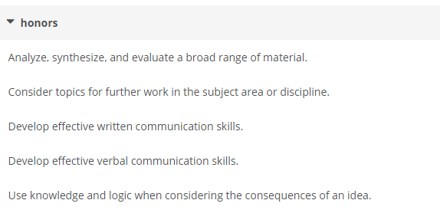

Slide 10
Faculty Section Specific Questions
Added by Faculty for individual sections
  Not benchmarked
Activated during administration set up
Coordination between setup admin, Dean, site admin

Slide 11
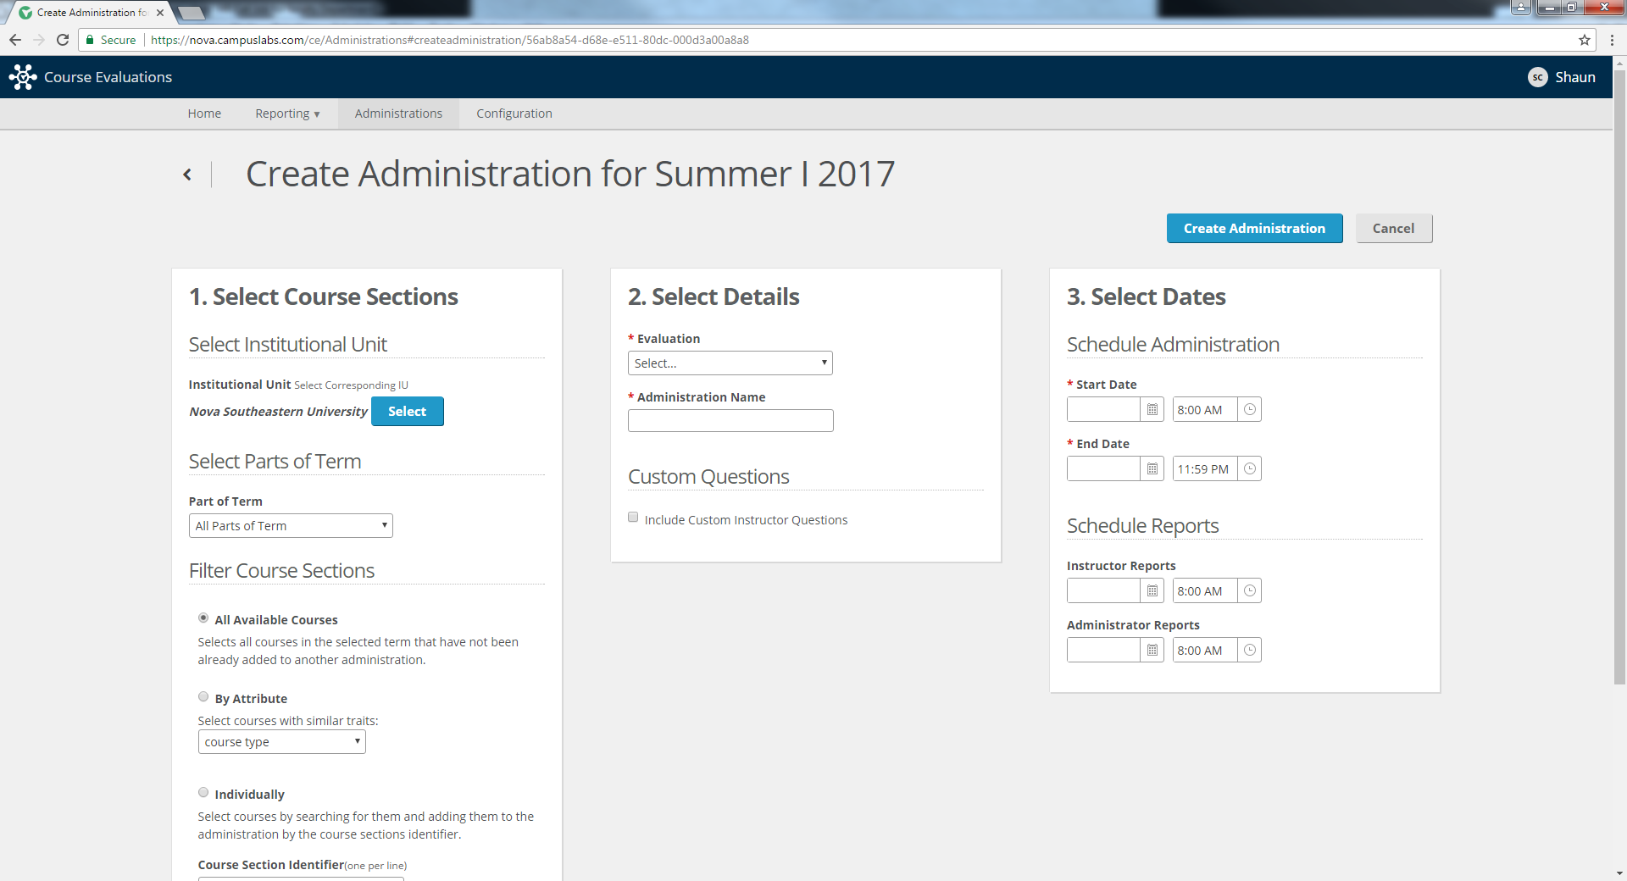

Slide 12
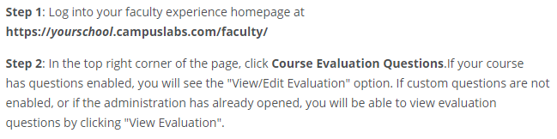
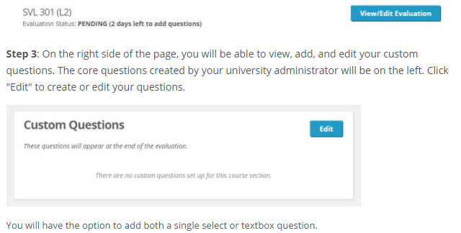
If Instructor questions are enabled when setting up the administration then faculty can add until it opens
Faculty Section Specific Questions
Notes:
https://courseevaluationsupport.campuslabs.com/hc/en-us/articles/204024838-Adding-Custom-Questions-to-a-Course-Section-by-Faculty

Slide 13
Learning Objective Weighting
Learning objective weights determined by faculty, dept chairs or dean
  Minor = 0, Important = 1 and Essential = 2
Only for Diagnostic and Learning Essential forms
Students will still rate all objectives

Slide 14
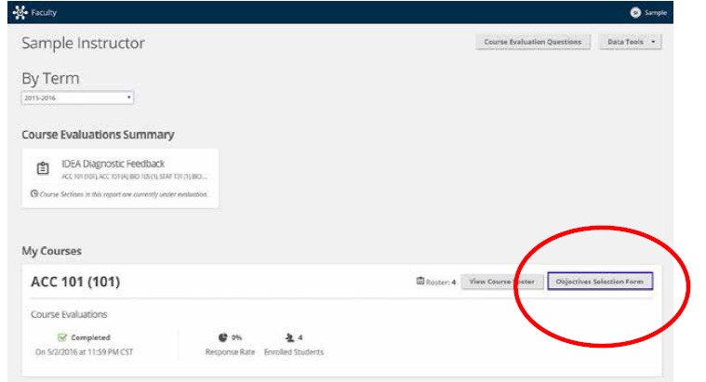

Slide 15
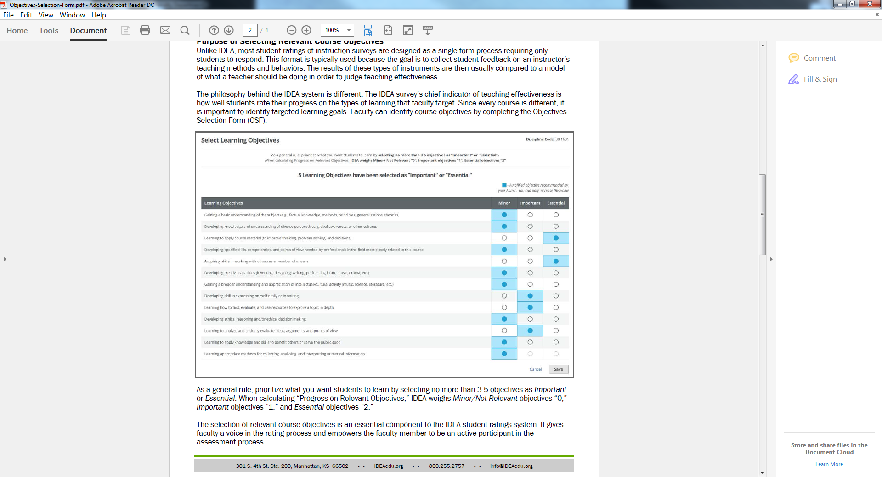

Slide 16
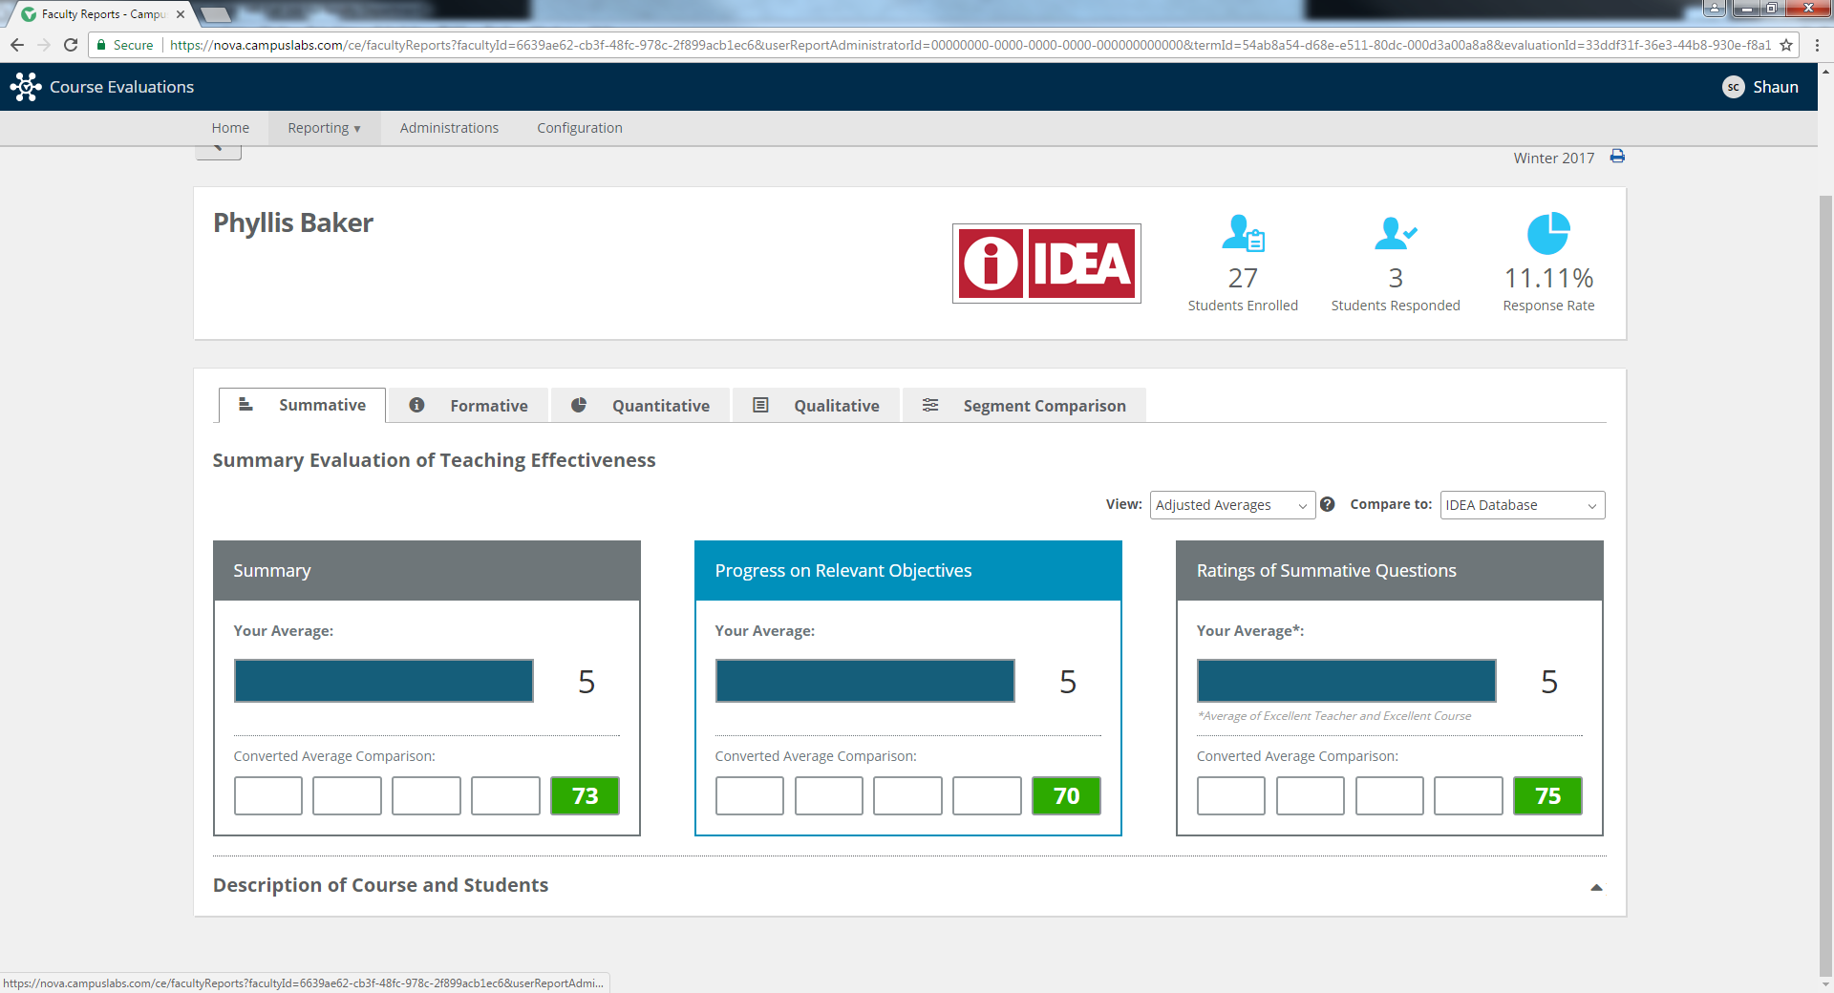
Faculty Report Example

Slide 17
